Slide 1

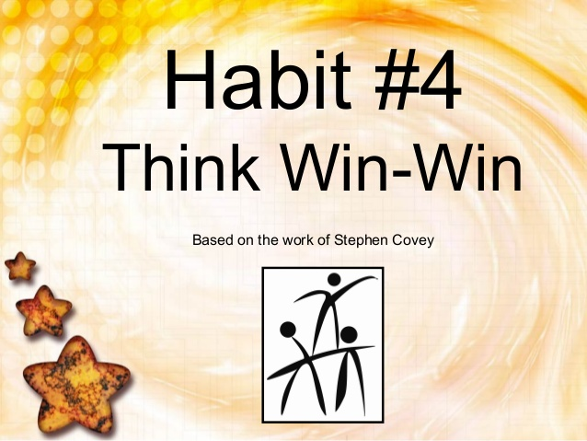
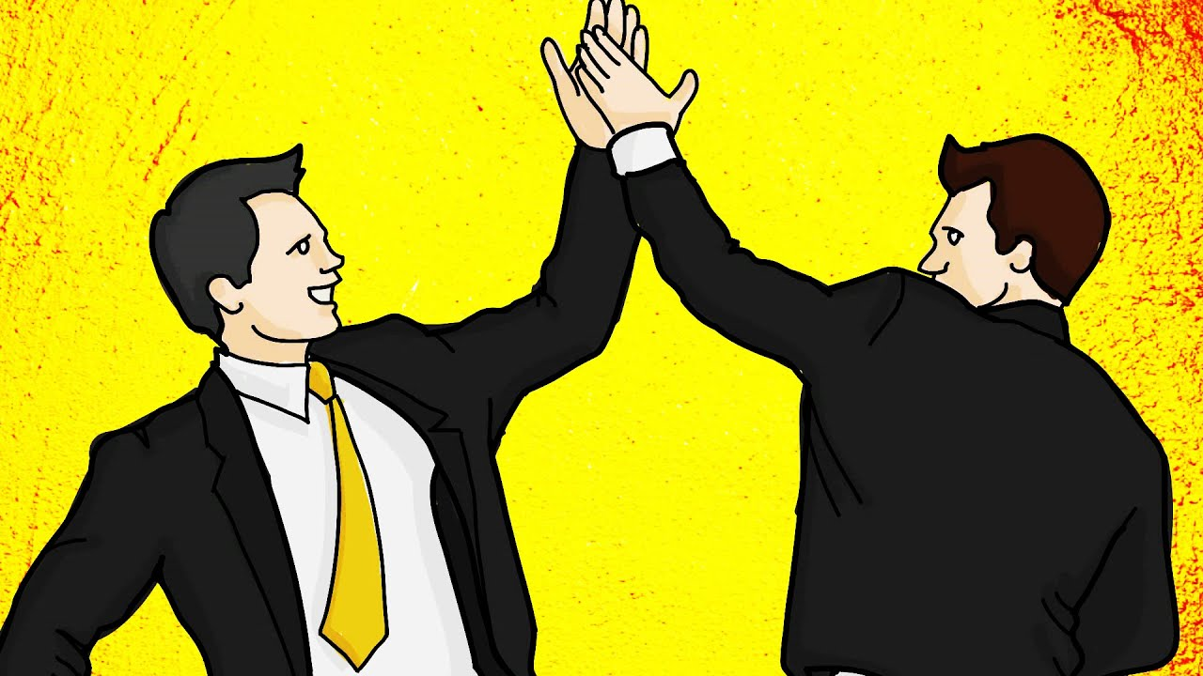
THINK WIN WIN
Sit Dolor Amet

Slide 2
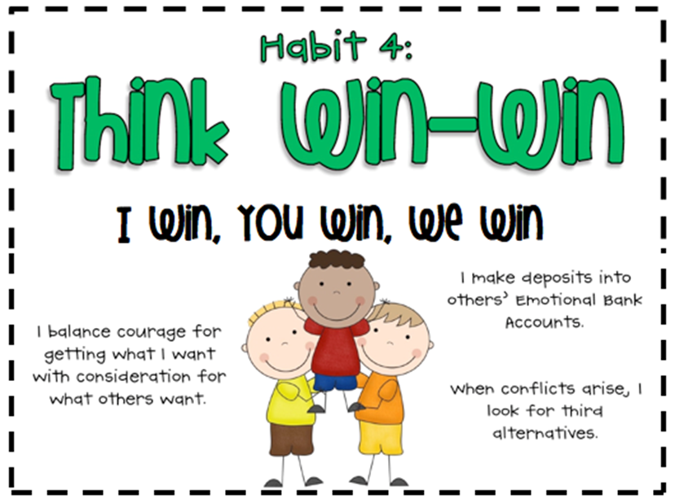
THINK WIN-WIN is.…. Neither your way nor my way but the BETTER way!
Habit of creating effective interpersonal skills
A frame of mind and heart committed to seeking mutually beneficial solutions.
Sees life as a cooperative arena, not a competitive one.
A balance between courage and consideration in seeking mutual benefit

Slide 3
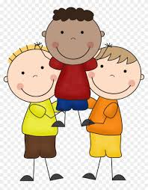
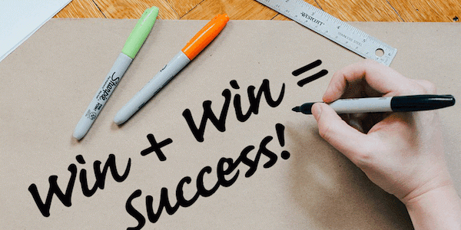
WHY WIN-WIN???
Helps to develop humility in you
Creates a sense of humbleness that enables you to find a mutual benefit situation.
All round satisfaction because neither one is a winner or a loser
Enables you to state what you want and allows you to consider the needs of others.
Win-Win Thinking will bring positive changes to your life
Win-Win will have a positive effect on your career

Slide 4
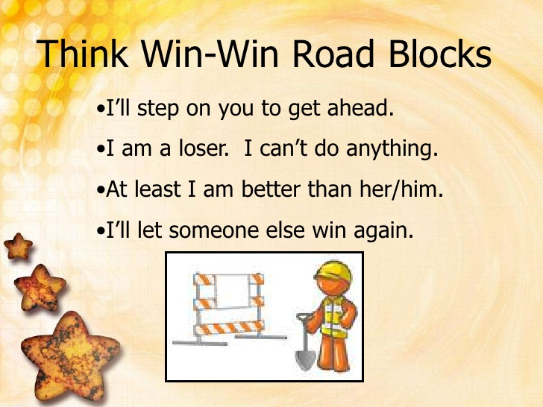
“Paradigms are powerful because they create the lens through which we see the world… If you want small changes in your life, work on your attitude. But if you want big and primary changes, work on your paradigm.” DR. STEPHEN R. COVEY
SIX PARADIGMS OF HUMAN INTERACTION
WIN – WIN (the all you can eat buffet)
WIN – LOSE (The totem pole)
LOSE – WIN (The Doormat)
LOSE – LOSE (The Downward Spiral)
WIN ( I am the only one)
WIN – WIN or NO DEAL

Slide 5
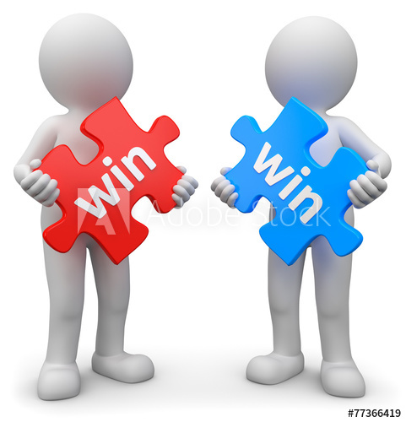
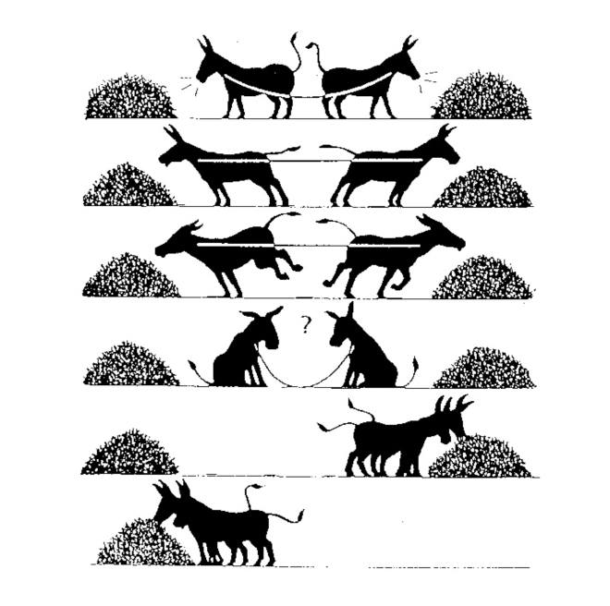


WIN - WIN
A belief that everyone can win
‘I wont step on you but I wont be your doormat either’
Care about other people and care about yourself too
Wanting another to win fills you with good feeling
There is plenty of success to go around – An endless buffet!

Slide 6

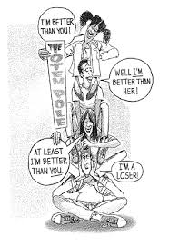
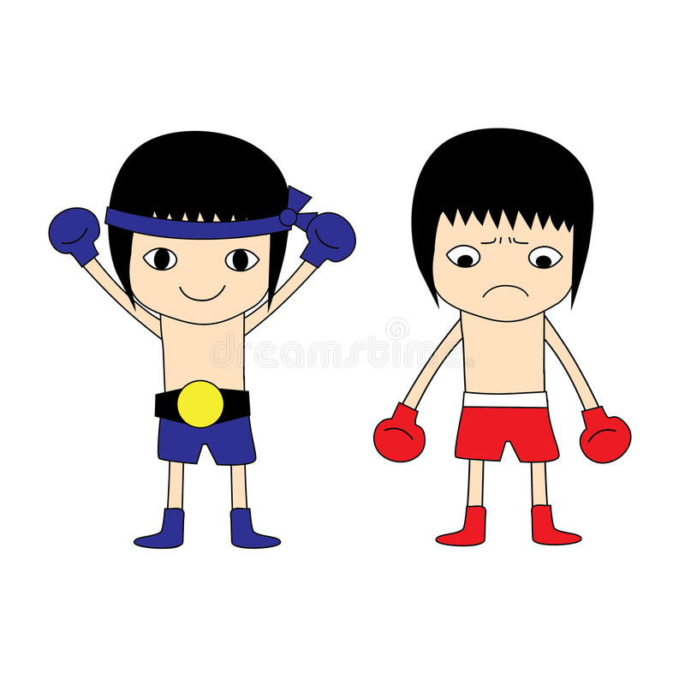
WIN- LOSE (The Totem pole)
‘If I win you lose’
It is a win at all cost!
Using other people for your own selfish purposes
Putting someone down to push you up
Getting your way without any concern for others
Being jealous of someone close to you
“I don’t care how good I am as long as I’m a notch higher than you on the totem pole.”

Slide 7


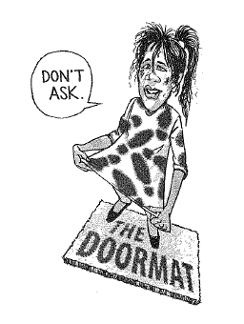
LOSE – WIN… The doormat
Lose–Win is weak. It is easy to get stepped on.
Sets low expectations and compromises standards again and again
Easier to let others have their way than to try to share your feelings
Gives in all the times in the name of peacemaker
Gives in to peer pressure
Hides feelings and always wants to be the nice guy

Slide 8

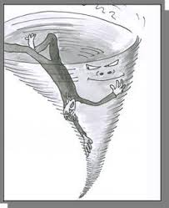
LOSE – LOSE ….The Downward spiral
“If I am going down then you are going down with me”
No one ends a winner
Happens when two Win/Lose people clash
Occurs also when someone becomes obsessed with another person
in a negative way
Revenge is also Lose-Lose. You may think you are winning but you
are only hurting yourself
It’s a NO WIN situation

Slide 9


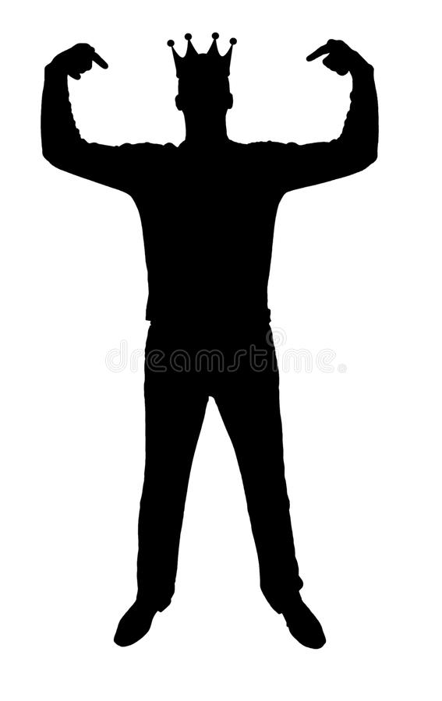
WIN…. (I am the only one)
The wish to win at all costs, other people don’t matter.
You want to get what you want whether the other person wins or loses
Only focus is on your own outcome
It’s an “every man for himself” mentality
.

Slide 10
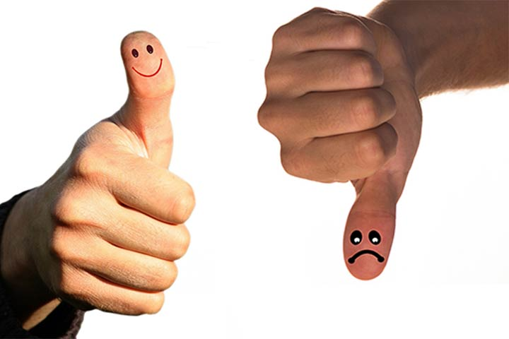
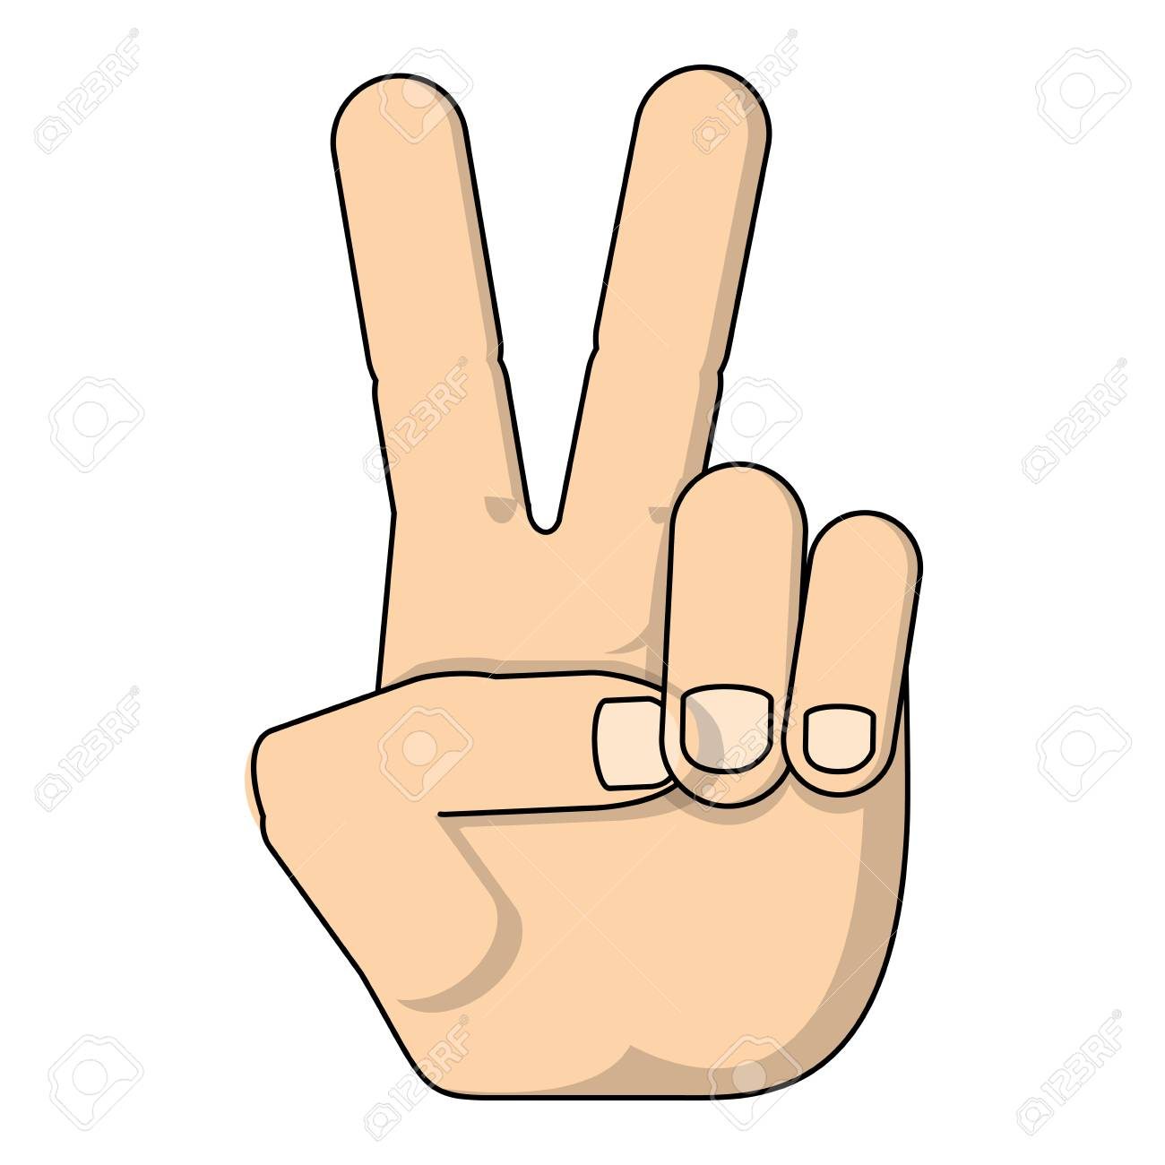
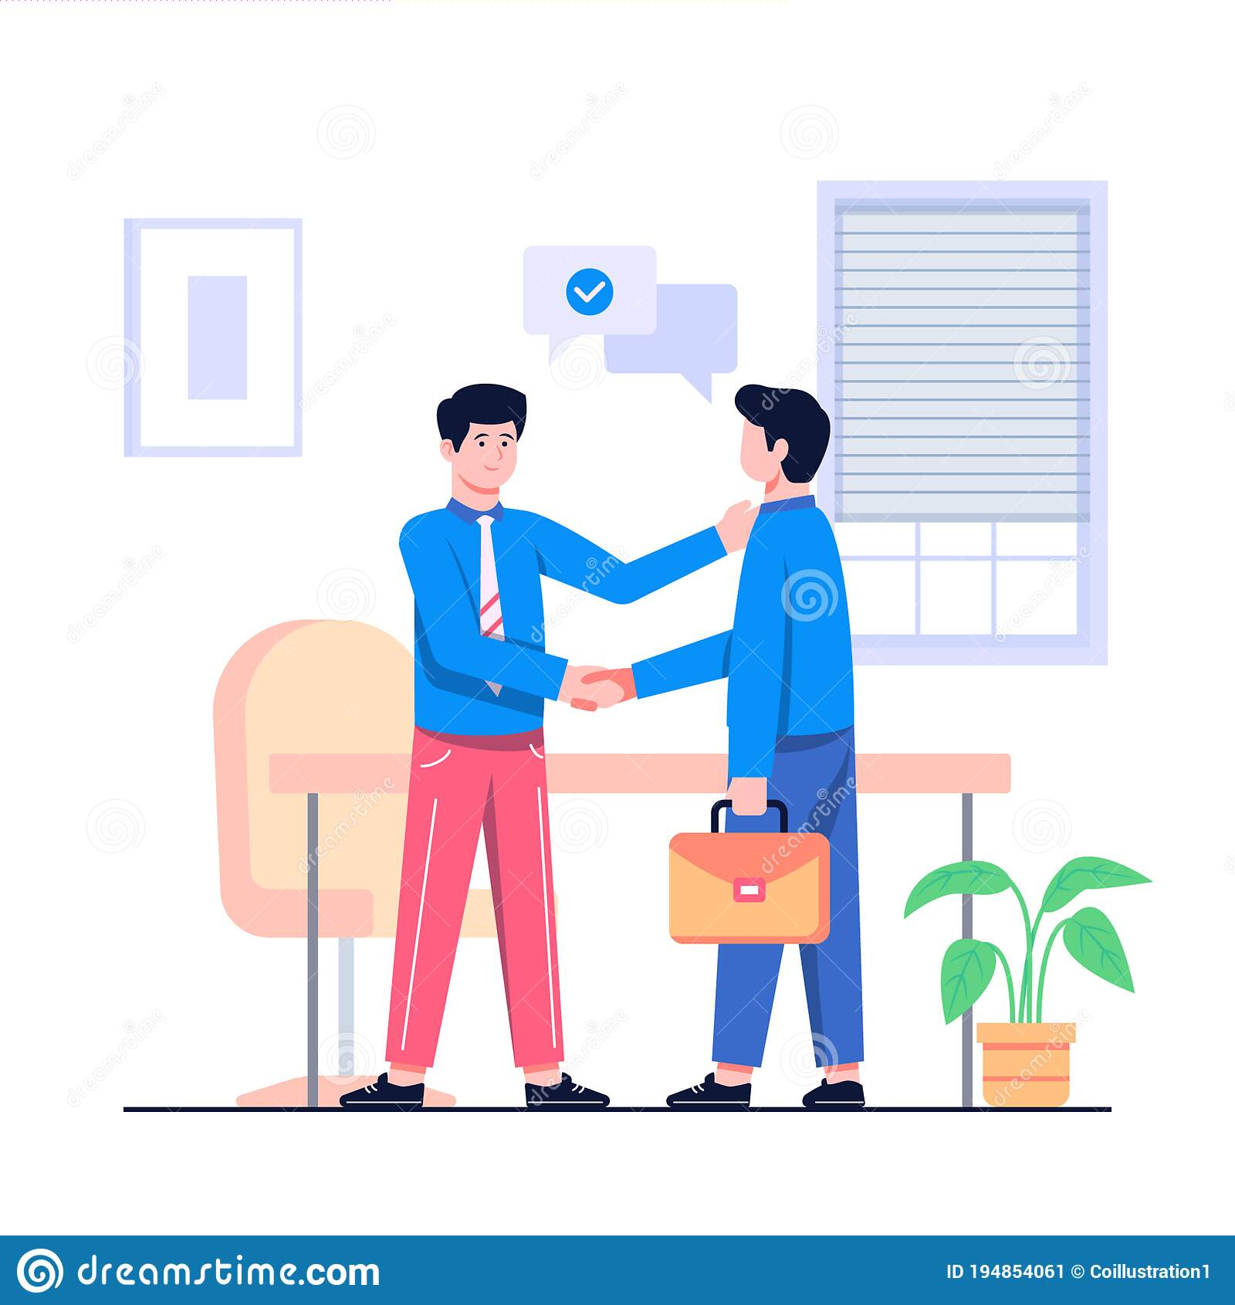
WIN-WIN OR NO DEAL =
With this framework:
You’re determined to find a solution that benefits both parties
And
If a mutually beneficial situation can’t be reached, then both parties “agree to disagree” and both walk away with no hard feelings.
It’s better for the relationship if you walk away from a negotiation altogether.
saves a lot of tension and problems in the relationship and keeps the relationship healthy
shows that you value the relationship more than the negotiation.
This is a typically realistic option at the beginning of a relationship or enterprise.

Slide 11
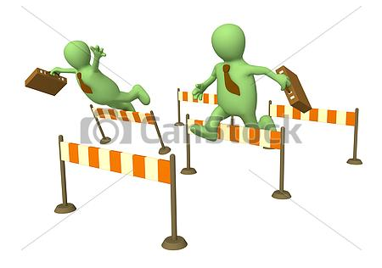
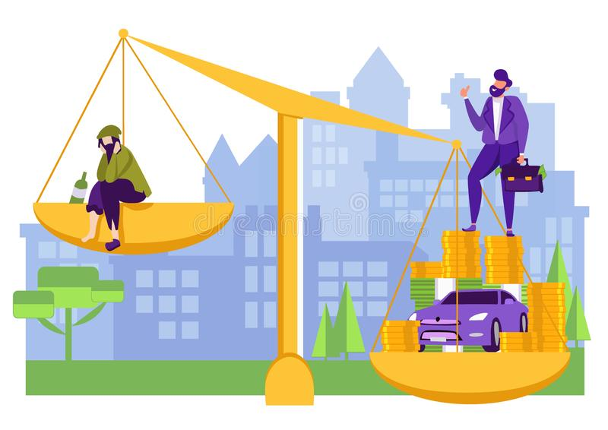
AVOID THE TUMOUR TWINS …two habits that can slowly eat you away from the inside : competing and comparing.
COMPETING
Healthy when you strive to do better and become your best
but
Unhealthy when you use your win to place yourself above others. When competition is used as a means of creating a self-image relative to others, the worst in a person comes out.
COMPARING
Comparing yourself with others is Bad News!
Each person is different Socially, mentally, and physically
You end up feeling inferior one moment and superior the next moment
The only good comparison is comparing yourself against your own potential.

Slide 12
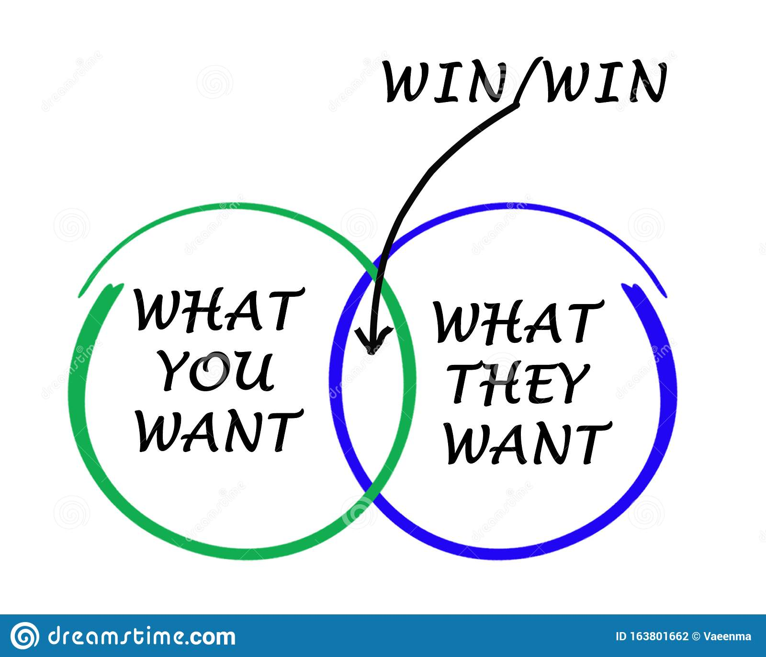
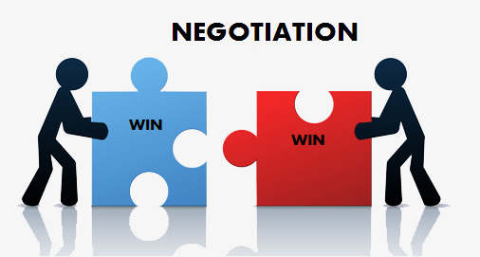
HOW TO THINK WIN-WIN
It all begins with you; Win the private victory first!
Personal security is the foundation for thinking Win- Win; Insecure people get jealous very easily
Avoid the tumour twins (Competing and Comparing)
Believe that everyone can win
You care about others and want them to succeed, but you also want to succeed yourself
See the problem from the other point of view, in terms of the needs and concerns of the other party.
Identify the key issues and concerns (not positions) involved.
Determine what results would make a fully acceptable solution.
Identify new options to achieve those results.

Slide 13
WHAT WIN-WIN IS AND IS NOT
IS | IS NOT
A courageous effort | Always being “nice”
The best way to get interdependent relationships | Always achievable
Human interaction supported by abundance mentality | A manipulative technique
A character based code for interactions | A personality based thought pattern

Slide 14

THINK WIN-WIN ……the right way
Try to spend most of the time thinking Win-Win
Start small and try to make an honest effort to try to change the way of your thinking
Slowly and steadily you will always succeed in thinking Win-Win
Win-Win Thinking will bring positive changes to your life
Win-Win will have a positive effect on your career

Slide 15
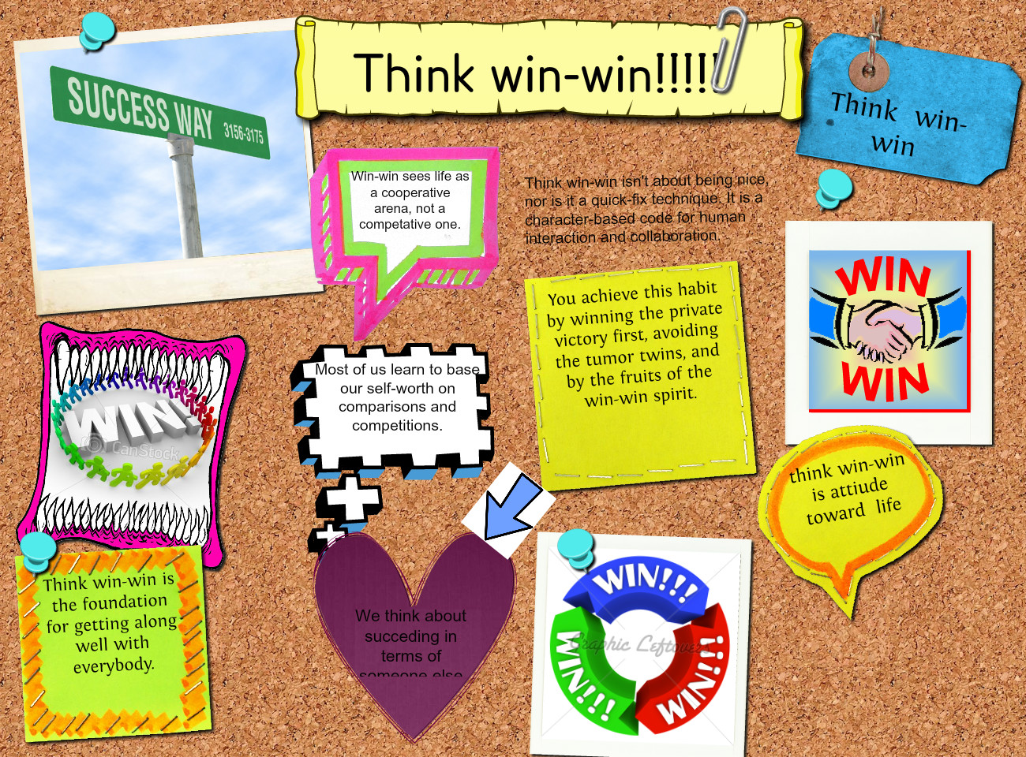
CONCLUSION

